Slide 1
Multiplicative relationships and direct proportion
Understanding multiplicative relationships: percentages and proportionality

Slide 2
how to use Oak lessons

Slide 3
I can appreciate the connection between multiplicative relationships and direct proportion.

Slide 4
Two variables are in direct proportion if they have a constant multiplicative relationship.

Slide 5

Multiplicative relationships and direct proportion
Direct proportion
Graphing proportional relationships

Slide 6
Direct proportion
We are familiar with multiplicative relationships in a variety of situations.
E.g.
converting between units of measurement
recipes
converting between units of currency
buying different amounts of an item
If two variables have a constant multiplicative relationship, they are in direct proportion.

Slide 7
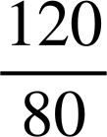
Direct proportion
We know that any variables which have a multiplicative relationship can be represented in a variety of ways.
Can you remember the different ways of representing multiplicative relationships?
double number lines
×
100
150
%
Score
80
120
×

Slide 8
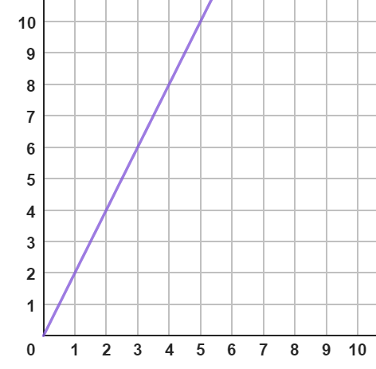
Direct proportion
ratio tables
% | Mass (kg)
% | Mass (kg)
100 | 5.5
 | 4.4
% | Mass (kg)
100 | 5.5
80 | 4.4
× 0.8
× 0.8
Does this graph show a multiplicative relationship?
It does. As the number of boxes doubles so does the cost.
graphs
Cost (£)
Number of boxes

Slide 9
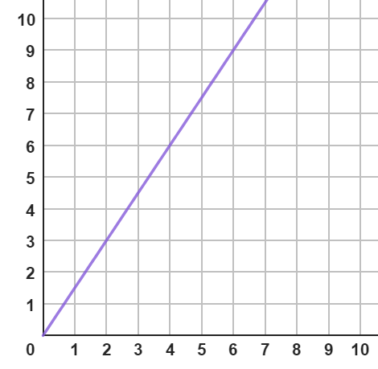
Direct proportion
This graph shows the relationship between two currencies used in a computer game.
Does it show a multiplicative relationship?
zags
2 zigs = 3 zags
4 zigs = 6 zags
So, yes it does which means zigs and zags are directly proportional to each other.
We could also represent this on a double number line.
zigs
0
1
2
3
4
5
6
7
8
9
zag
zig
0
1
2
3
4
5
6

Slide 10
Direct proportion
The quickest and easiest way to decide if two variables are in direct proportion is by checking as one variable doubles so does the other.
Does this table show a directly proportional relationship between A and B?
A | B
2 | 6
4 | 12
10 | 30
12 | 36
Yes, A and B do have a directly proportional relationship.
× 2
× 2
× 6
× 6

Slide 11

Direct proportion
Does this table show a directly proportional relationship between A and B?
A | B
1 | 3
2 | 4
3 | 5
4 | 6
No, A and B do not have a directly proportional relationship as the multiplier between the values of A is not the same as B.
× 2
×

Slide 12

Direct proportion
A | B
2 | 7
4 | 13
6 | 19
8 | 25
This table shows a directly proportional relationship between A and B.
A and B are going up by the same amount each time.
When A doubles B does not double.

Slide 13
Direct proportion
1) Which of the following show a directly proportional relationship between A and B?
a)
b)
c)
A | B
3 | 12
6 | 24
8 | 32
10 | 40
A | B
4 | 7
6 | 11
8 | 15
10 | 19
A | B
5 | 35
15 | 105
20 | 140
30 | 210
d)
e)
f)
A | B
4 | 2
7 | 3.5
9 | 4.5
14 | 7
A | B
3 | 13
4 | 16
5 | 19
8 | 28
A | B
100 | 25
80 | 20
75 | 18.75
40 | 10

Slide 14
Direct proportion
2) Below are some variables which are directly proportional to each other.
Jun is painting his neighbour’s fence. He paints one fence every 40 minutes.
Andeep is making necklaces for the school fete. He makes 2 necklaces every 7 minutes.
5 miles is equivalent to 8 km.
A box of tiles covering 0.75 m², costs £15
Sofia’s dog eats 3 tins of food every 4 days.
For each situation draw the following:
i) A double number line and mark on at least 3 equivalents
ii) A ratio table

Slide 15
Direct proportion
1) Which of the following show a directly proportional relationship between A and B?
a)
b)
c)
A | B
3 | 12
6 | 24
8 | 32
10 | 40
A | B
4 | 7
6 | 11
8 | 15
10 | 19
A | B
5 | 35
15 | 105
20 | 140
30 | 210
d)
e)
f)
A | B
4 | 2
7 | 3.5
9 | 4.5
14 | 7
A | B
3 | 13
4 | 16
5 | 19
8 | 28
A | B
100 | 25
80 | 20
75 | 18.75
40 | 10

Slide 16
Direct proportion
2) Below are some variables which are directly proportional to each other.
a) Jun is painting his neighbour’s fence. He paints one fence every 40 minutes.
i) A double number line and mark on at least 3 equivalents
1
2
5
6
Fence
Time
40
80
200
240
ii) A ratio table
Fence | Time
1 | 40
6 | 240

Slide 17
Direct proportion
2) Below are some variables which are directly proportional to each other.
b) Andeep is making necklaces for the school fete. He makes 2 necklaces every 7 minutes.
i) A double number line and mark on at least 3 equivalents
ii) A ratio table
2
4
10
12
Necklaces
Time
7
14
35
42
Necklaces | Time
2 | 7
10 | 35

Slide 18
Direct proportion
2) Below are some variables which are directly proportional to each other.
c) 5 miles is equivalent to 8 km.
i) A double number line and mark on at least 3 equivalents
ii) A ratio table
5
10
25
30
Miles
Kilometres
8
16
40
48
Miles | Kilometres
5 | 8
10 | 16

Slide 19
Direct proportion
2) Below are some variables which are directly proportional to each other.
d) A box of tiles covering 0.75 m², costs £15
i) A double number line and mark on at least 3 equivalents
ii) A ratio table
0.75
1.5
5
6
Area
Cost
15
30
100
120
Area | Cost (£)
0.75 | 15
10 | 200

Slide 20
Direct proportion
2) Below are some variables which are directly proportional to each other.
e) Sofia’s dog eats 3 tins of food every 4 days.
i) A double number line and mark on at least 3 equivalents
ii) A ratio table
3
6
15
18
Tins
Day
4
8
20
24
Tins | Day
3 | 4
15 | 20

Slide 21
Multiplicative relationships and direct proportion
Direct proportion
Graphing proportional relationships

Slide 22


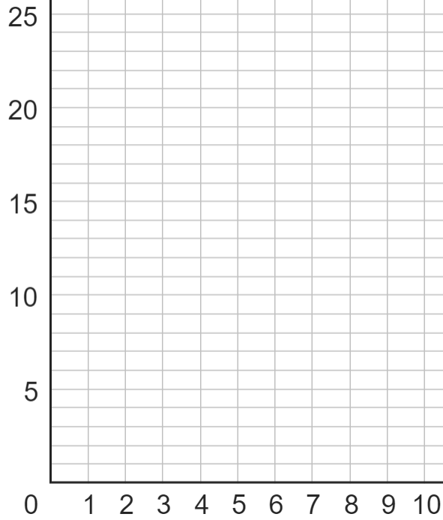
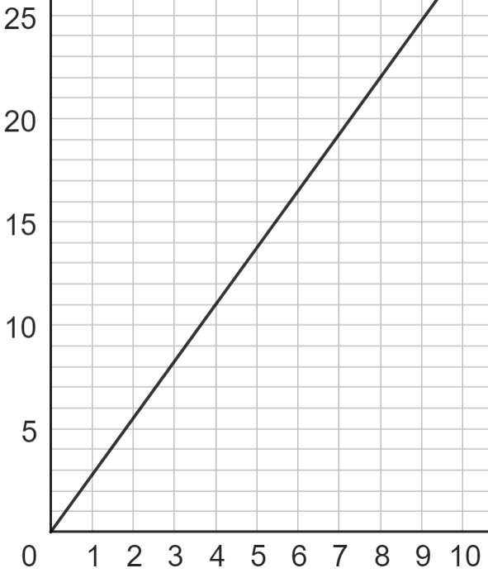
Graphing proportional relationships
The cost of strawberries is directly proportional to the number of boxes.
3 boxes of strawberries cost £8.25
We can represent this situation on a graph.
cost
Boxes | Cost (£)
3 | 8.25
6
Boxes | Cost (£)
3 | 8.25
6 | 16.50
x
× 2
× 2
x
Can you spend exactly £20 on strawberries?
No, reading from the graph the number of boxes is not an integer.
boxes
x

Slide 23

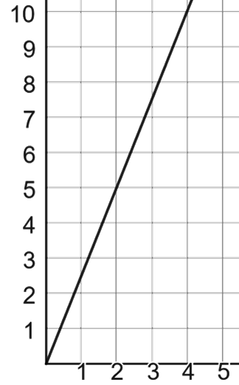
Graphing proportional relationships
This graph shows the directly proportional relationship between milkshakes and cost.
Can you spend exactly £7 on milkshakes?
cost
No, £7 is between the cost of 2 and 3 milkshakes.
milkshakes

Slide 24

Graphing proportional relationships
cost
We know that variables which are directly proportional can be represented on a double number line and a graph.
The cost of watermelons is directly proportional to the number of watermelons bought.
£2 each
6
2
2
2
4
4
4
6
6
6
cost
cost
2
4
6
cost
4
cost
2
4
6
2
4
6
cost
cost
2
2
4
6
2
4
6
cost
cost
0
watermelons
On a double number line:
1
2
3

Slide 25
Graphing proportional relationships
cost
We know that variables which are directly proportional can be represented on a double number line and a graph.
The cost of watermelons is directly proportional to the number of watermelons bought.
£2 each
6
4
2
0
watermelons
On a double number line:
1
2
3

Slide 26
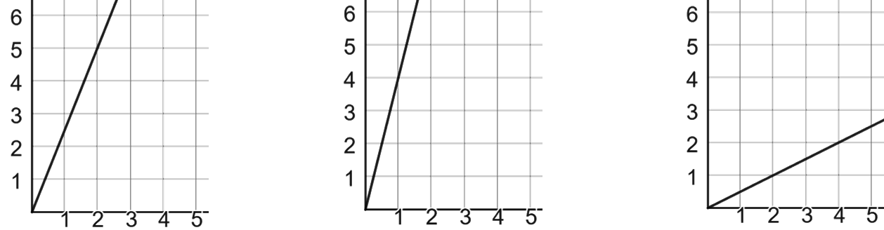
Graphing proportional relationships
Match each graph to the situations they represent.
1 box costs £4
1 box costs 50p
1 box costs £2.50
Cost (£)
Cost (£)
Cost (£)
Amount
Amount
Amount

Slide 27
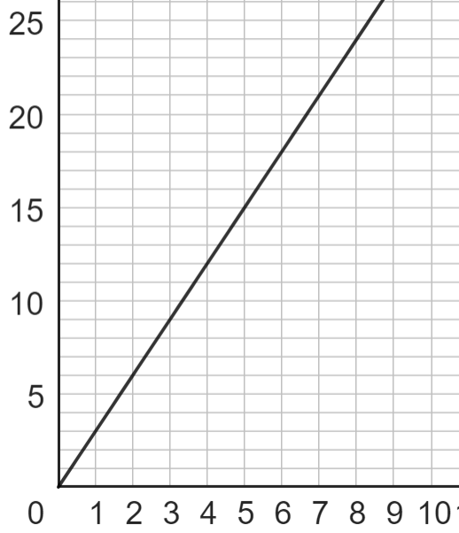
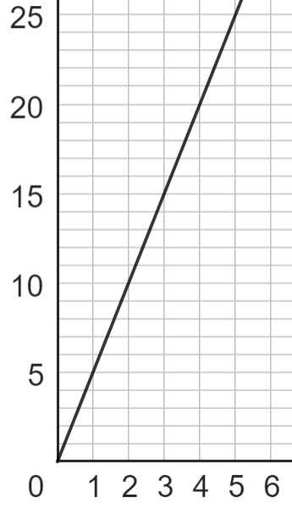
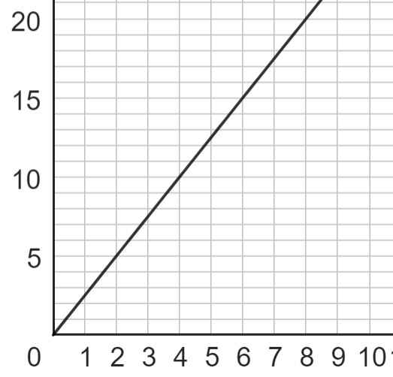
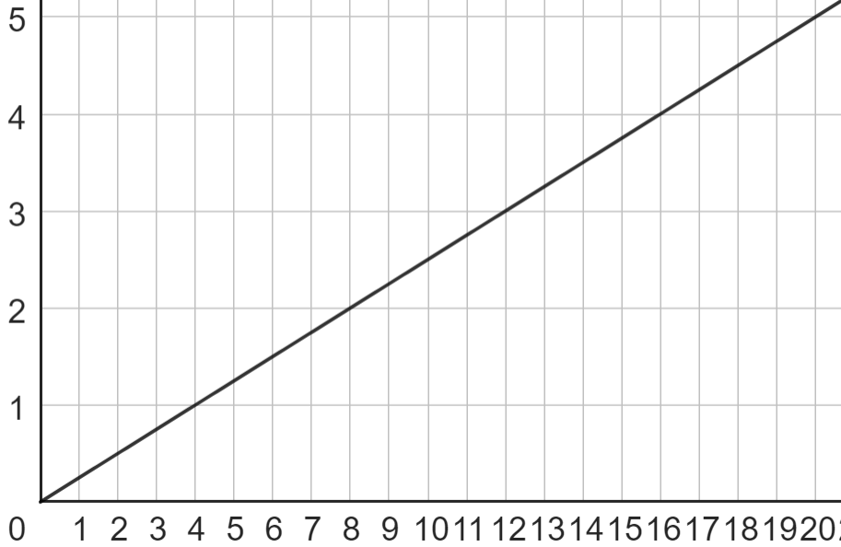
Graphing proportional relationships
Match each table to the correct graph and fill in the missing values:
A
B
C
D
2 | 5
7 | 17.5
3
8
2 | 6
5 | 15
3
4
4 | 1
6 | 1.5
8
16
3 | 15
7 | 35
2
5

Slide 28
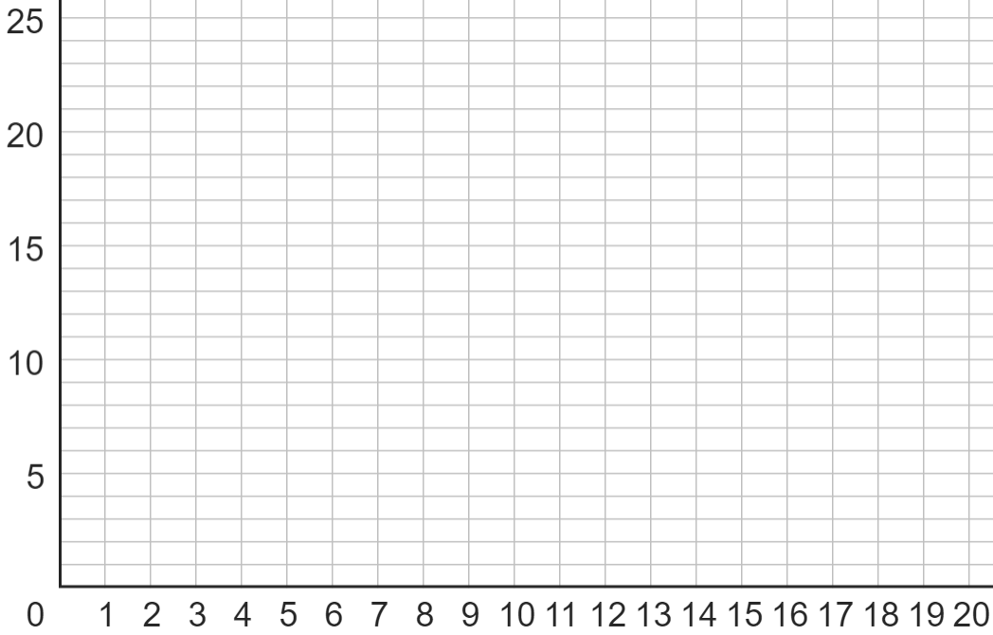
Graphing proportional relationships
2) The following all have a directly proportional relationship. Plot a graph of each.
a)
2 | 6
3
4
6

Slide 29
Graphing proportional relationships
2) The following all have a directly proportional relationship. Plot a graph of each.
b)
4 | 2
8
12
16

Slide 30
Graphing proportional relationships
2) The following all have a directly proportional relationship. Plot a graph of each.
c)
1 | 1.5
2
4
8

Slide 31
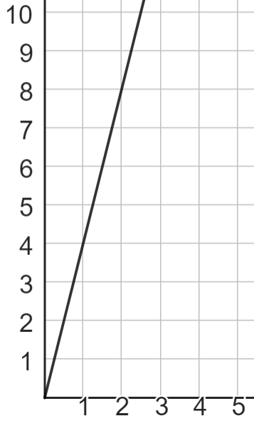
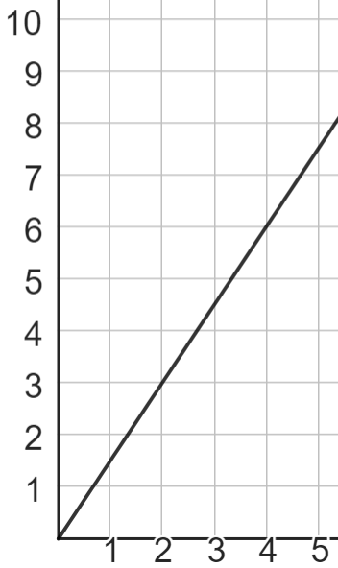
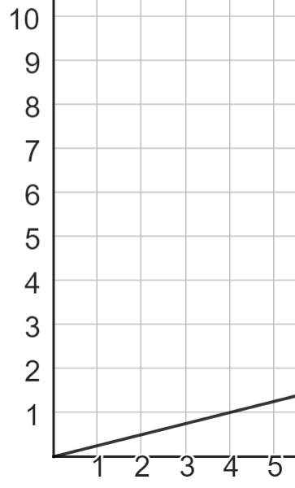
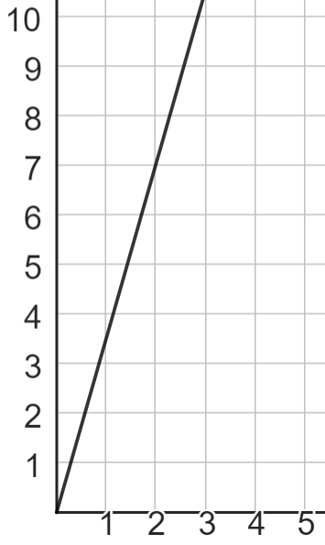
Graphing proportional relationships
3) Match each double number line to the correct graph:
y
A
y
B
y
C
y
D
x
x
x
x
2
4
1
4
0.5
4
2
5
x
x
x
x
y
y
y
y
7
14
0.25
1
0.75
6
8
20

Slide 32
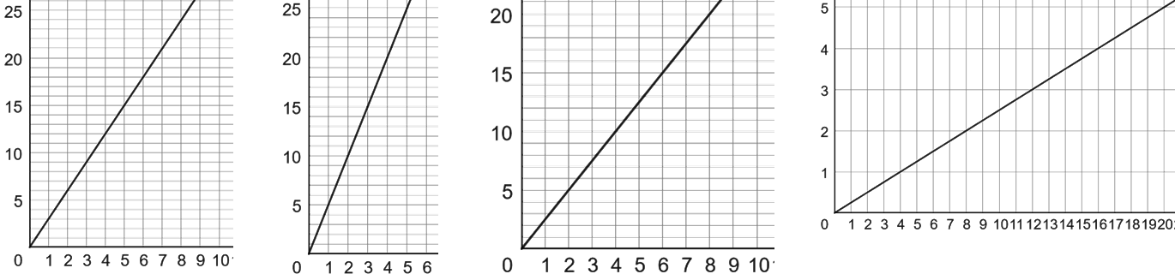
Graphing proportional relationships
1) Match each table to the correct graph and fill in the missing values:
A
B
C
D
2 | 5
7 | 17.5
3 | 7.5
8 | 20
2 | 6
5 | 15
3 | 9
4 | 12
4 | 1
6 | 1.5
8 | 2
16 | 4
3 | 15
7 | 35
2 | 10
5 | 25
C
A
D
B

Slide 33
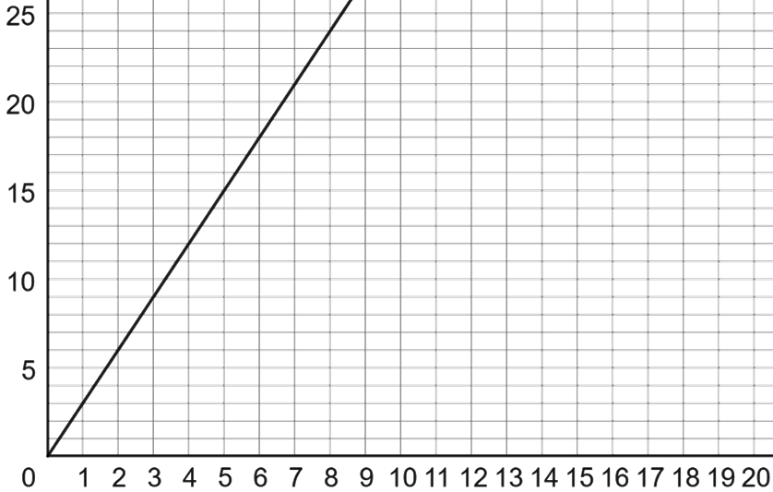
Graphing proportional relationships
2) The following all have a directly proportional relationship. Plot a graph of each.
a)
2 | 6
3 | 9
4 | 12
6 | 18

Slide 34
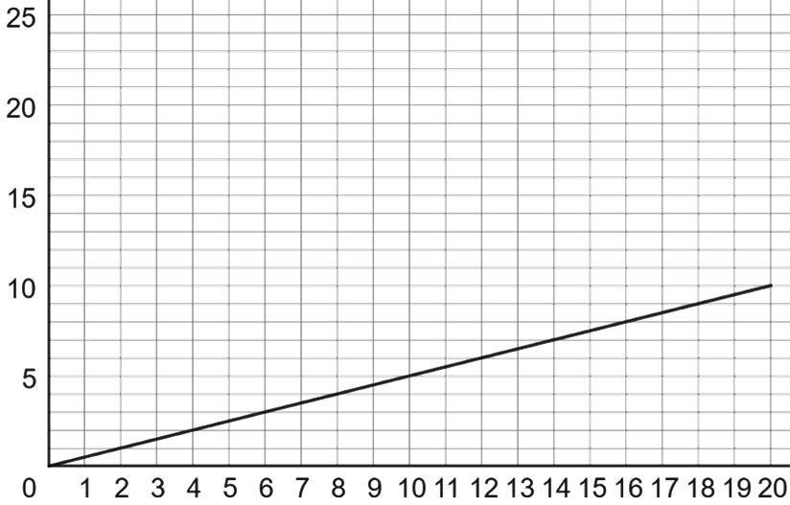
Graphing proportional relationships
2) The following all have a directly proportional relationship. Plot a graph of each.
b)
4 | 2
8 | 4
12 | 6
16 | 8

Slide 35
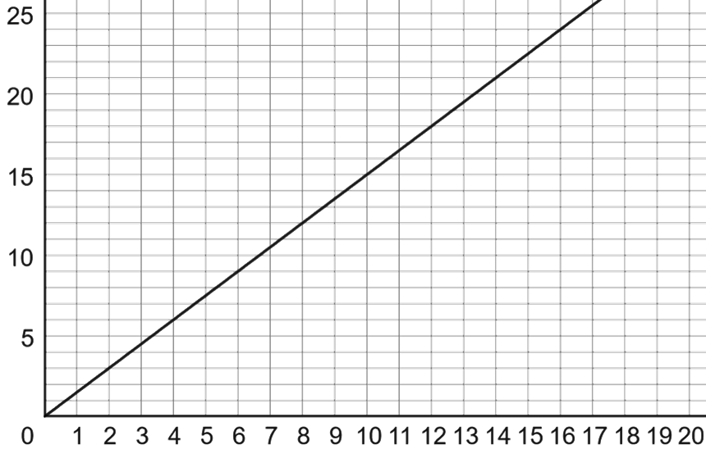
Graphing proportional relationships
2) The following all have a directly proportional relationship. Plot a graph of each.
c)
1 | 1.5
2 | 3
4 | 6
8 | 12

Slide 36
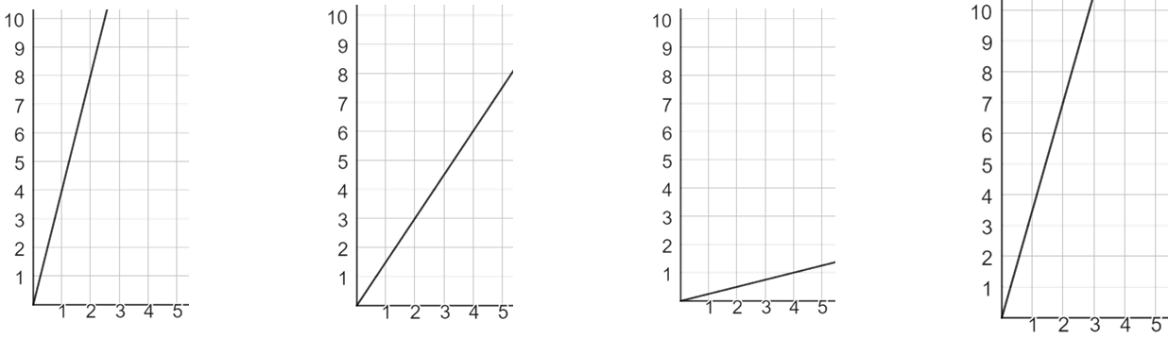
Graphing proportional relationships
3) Match each double number line to the correct graph:
y
A
y
B
y
C
y
D
x
x
x
x
2
4
1
4
0.5
4
2
5
x
x
x
x
D
C
B
A
y
y
y
y
7
14
0.25
1
0.75
6
8
20

Slide 37
Multiplicative relationships and direct proportion
If two variables have a constant multiplicative relationship, they are in direct proportion.
E.g.
converting between units of measurement
recipes
converting between units of currency
buying different amounts of an item
Variables which are directly proportional can be represented on a double number line, in a ratio table and on a graph.

Slide 38

© Oak National Academy 2024.
Produced in partnership with Mathematics in Education and Industry.
Licensed on the Open Government Licence v3.0, except where otherwise stated. See Oak terms and conditions.

